Slide 1

Recurrent
Neural Networks

Slide 2
Deep Learning
We’ve used Neural Networks to solve Classification and Regression problems, but we still haven’t seen how Neural Networks can deal with sequence information.
For this we use Recurrent Neural Networks

Slide 3
Deep Learning
RNN Theory
Basic Manual RNN
Vanishing Gradients
LSTM and GRU Units
Time Series with RNN
Time Series Exercise / Solutions
Word2Vec

Slide 4
Let’s get started!

Slide 5
Recurrent Neural Networks Theory

Slide 6
Deep Learning
Examples of Sequences
Time Series Data (Sales)
Sentences
Audio
Car Trajectories
Music

Slide 7
Deep Learning
Let’s imagine a sequence:
[1,2,3,4,5,6]
Would you be able to predict a similar sequence shifted one time step into the future?
[2,3,4,5,6,7]

Slide 8
Deep Learning
Let’s imagine a sequence:
[1,2,3,4,5,6]
Would you be able to predict a similar sequence shifted one time step into the future?
[2,3,4,5,6,7]

Slide 9
Deep Learning
Normal Neuron in Feed Forward Network
Output
Activation Function
Σ
Aggregation of Inputs
Input

Slide 10
Deep Learning
Recurrent Neuron
Sends output back to itself!
Let’s see what this looks like over time!
Output
Σ
Input

Slide 11
Deep Learning
Recurrent Neuron
Output at t-1
Output at t
Output at t+1
Output
=
Σ
Σ
Σ
Σ
Input
Input
at t-1
Input at t
Input at t+1
Time

Slide 12
Deep Learning
Cells that are a function of inputs from previous time steps are also known as memory cells.
RNN are also flexible in their inputs and outputs, for both sequences and single vector values.

Slide 13
Deep Learning
We can also create entire layers of Recurrent Neurons...

Slide 14
Deep Learning
RNN Layer with 3 Neurons:
X
y

Slide 15
Deep Learning
“Unrolled” layer.
Output at t=0
Output at t+1
Output at t+2
Input
at t=0
Input at t+1
Input at t+2
Time

Slide 16
Deep Learning
RNN are also very flexible in their inputs and outputs.
Let’s see a few examples.

Slide 17
Deep Learning
Sequence to Sequence
Y₀
Y₁
Y₂
Y₃
Y₄
X₀
X₁
X₂
X₃
X₄

Slide 18
Deep Learning
Sequence to Vector
Y₀
Y₁
Y₂
Y₃
Y₄
X₀
X₁
X₂
X₃
X₄

Slide 19
Deep Learning
Vector to Sequence
Y₀
Y₁
Y₂
Y₃
Y₄
X₀
0
0
0
0

Slide 20
Deep Learning
Let’s explore how we could build a simple RNN model in TensorFlow manually.
Afterwards we’ll see how to use TensorFlow’s built in RNN API classes!

Slide 21
Manual RNN with TF

Slide 22
Deep Learning
In this lecture we’ll manually create a 3 neuron RNN layer with TensorFlow.
The main idea to focus on here is the input format of the data.
Let’s quickly review what we will create.

Slide 23
Deep Learning
We’ll construct the following RNN Layer:
X
y

Slide 24
Deep Learning
“Unrolled” layer.
Output at t=0
Output at t+1
Input
at t=0
Input at t+1

Slide 25
Deep Learning
We’ll start by running the RNN for 2 batches of data, t=0 and t=1
Each Recurrent Neuron has 2 sets of weights:
Wx for input weights on X
Wy for weights on output of original X

Slide 26
Example of RNN Data
t=0 t=1 t=2 t=3 t=4
[ The, brown, fox, is, quick]
[ The, red, fox, jumped, high]
words_in_dataset[0] = [The, The]
words_in_dataset[1] = [brown, red]
words_in_dataset[2] = [fox,fox]
words_in_dataset[3] = [is, jumped]
words_in_dataset[4] = [quick, high]
num_batches = 5, batch_size = 2, time_steps = 5

Slide 27
Vanishing Gradients

Slide 28
Deep Learning
Backpropagation goes backwards from the output to the input layer, propagating the error gradient.
For deeper networks issues can arise from backpropagation, vanishing and exploding gradients!

Slide 29
Deep Learning
As you go back to the “lower” layers, gradients often get smaller, eventually causing weights to never change at lower levels.
The opposite can also occur, gradients explode on the way back, causing issues.

Slide 30
Deep Learning
Let’s discuss why this might occur and how we can fix it.
Then in the next lecture we’ll discuss how these issues specifically affect RNN and how to use LSTM and GRU to fix them.

Slide 31
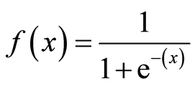
Deep Learning
Why does this happen?
1
Output
0
0
z = wx + b

Slide 32
Deep Learning
Why does this happen?
1
Output
0
0
z = wx + b

Slide 33
Deep Learning
Using Different Activation Functions
Output
0
z = wx + b

Slide 34
Deep Learning
The ReLu doesn’t saturate positive values.
Output
0
z = wx + b

Slide 35
Deep Learning
“Leaky” ReLU
Output
0
z = wx + b

Slide 36
Deep Learning
Exponential Linear Unit (ELU)
1
Output
0
-1
0
z = wx + b

Slide 37
Deep Learning
Another solution is to perform batch normalization, where your model will normalize each batch using the batch mean and standard deviation.

Slide 38
Deep Learning
Apart from batch normalization, researchers have also used “gradient clipping”, where gradients are cut off before reaching a predetermined limit (e.g. cut off gradients to be between -1 and 1)

Slide 39
Deep Learning
RNN for Time Series present their own gradient challenges, let’s explore special neuron units that help fix these issues!

Slide 40
LSTM and GRU

Slide 41
Deep Learning
Many of the solutions previously presented for vanishing gradients can also apply to RNN: different activation functions, batch normalizations, etc…
However because of the length of time series input, these could slow down training

Slide 42
Deep Learning
A possible solution would be to just shorten the time steps used for prediction, but this makes the model worse at predicting longer trends.

Slide 43
Deep Learning
Another issue RNN face is that after awhile the network will begin to “forget” the first inputs, as information is lost at each step going through the RNN.
We need some sort of “long-term memory” for our networks.

Slide 44
Deep Learning
The LSTM (Long Short-Term Memory) cell was created to help address these RNN issues.
Let’s go through how an LSTM cell works!

Slide 45
Deep Learning
A typical RNN
Output at t-1
Output at t
Output at t+1
Input
at t-1
Input at t
Input at t+1

Slide 46
Deep Learning
A typical RNN cell
Output at t-1
Output at t
Output at t+1
h_{t-1}
h_{t}
h_{t+1}
h_{t-1}
h_{t}
h_{t+1}
tanh
Input
at t-1
Input at t
Input at t+1

Slide 47
An LSTM Cell
Output at t
Here we can see the entire LSTM cell.
Let’s go through the process!
X
+
tanh
X
X
σ
σ
tanh
σ
Input at t
http://colah.github.io/posts/2015-08-Understanding-LSTMs/

Slide 48
An LSTM Cell
h_{t}
Here we can see the entire LSTM cell.
Let’s go through the process!
C_{t-1}
C_{t}
X
+
tanh
X
X
σ
σ
tanh
σ
h_{t-1}
h_{t}
x_{t}

Slide 49
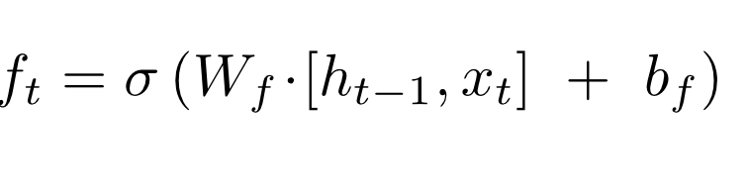
An LSTM Cell
h_{t}
C_{t-1}
C_{t}
X
+
tanh
f_{t}
X
X
σ
σ
tanh
σ
h_{t-1}
h_{t}
x_{t}

Slide 50
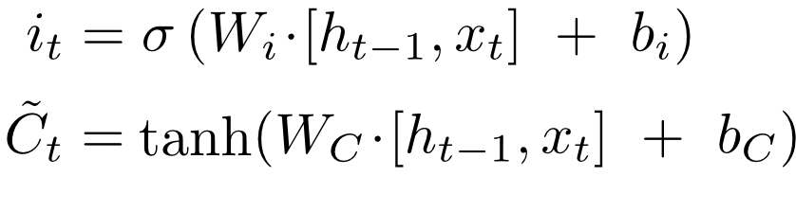
An LSTM Cell
h_{t}
C_{t-1}
C_{t}
X
+
tanh
i_{t}
X
~
C_{t}
X
σ
σ
tanh
σ
h_{t-1}
h_{t}
x_{t}

Slide 51
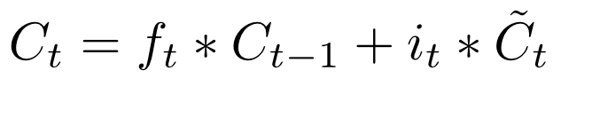
An LSTM Cell
h_{t}
C_{t-1}
C_{t}
X
+
tanh
f_{t}
i_{t}
X
~
C_{t}
X
σ
σ
tanh
σ
h_{t-1}
h_{t}
x_{t}

Slide 52
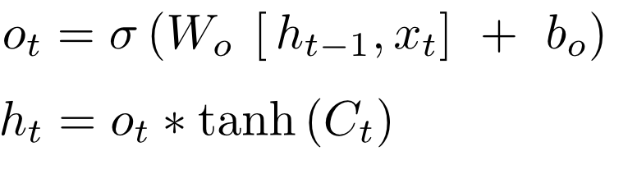
An LSTM Cell
h_{t}
C_{t-1}
C_{t}
X
+
tanh
X
X
σ
σ
tanh
σ
h_{t-1}
h_{t}
x_{t}

Slide 53
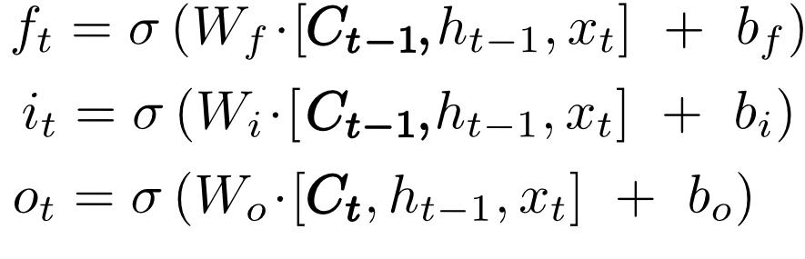
An LSTM Cell with “peepholes”
h_{t}
C_{t-1}
C_{t}
X
+
tanh
X
X
σ
σ
tanh
σ
h_{t-1}
h_{t}
x_{t}

Slide 54
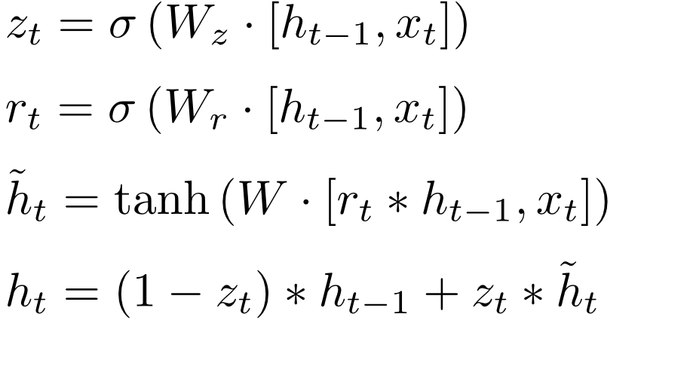
Gated Recurrent Unit (GRU)
h_{t}
h_{t-1}
C_{t}
X
+
X
r_{t}
1-
z_{t}
X
σ
σ
tanh
x_{t}

Slide 55
Deep Learning
Fortunately TensorFlow comes with these neuron models built into a nice API, making it easy to swap them in and out.
Up next we’ll explore using this TensorFlow RNN API for Time Series prediction and generation!

Slide 56
RNN with TF API

Slide 57
Deep Learning
Now that we understand various possible improvements for RNN, let’s use TensorFlow built-in tf.nn function API to solve sequence problems!

Slide 58
Deep Learning
Recall our original sequence thought exercise:
[1,2,3,4,5,6]
Can we predict the sequence shifted one time step forward?
[2,3,4,5,6,7]

Slide 59
Deep Learning
What about this time series?
[0,0.84,0.91,0.14,-0.75,-0.96,-0.28]

Slide 60
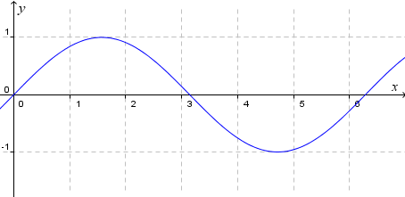
Deep Learning
What about this time series?
[0,0.84,0.91,0.14,-0.75,-0.96,-0.28]
It’s actually just sin(x):
[0.84,0.91,0.14,-0.75,-0.96,-0.28,0.65]

Slide 61
Deep Learning
We’ll start by creating a RNN that attempts to predict a time series shifted over 1 unit into the future.
Then we’ll attempt to generate new sequences with a seed series.

Slide 62
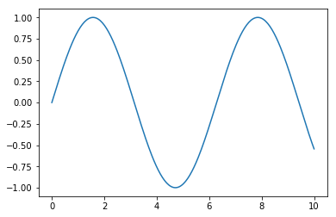
Deep Learning
We’ll first create a simple class to generate sin(x) and also grab random batches of sin(x)

Slide 63
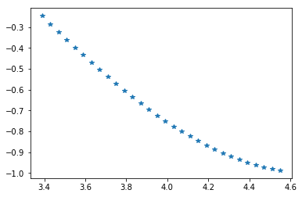
Deep Learning
We’ll first create a simple class to generate sin(x) and also grab random batches of sin(x)

Slide 64
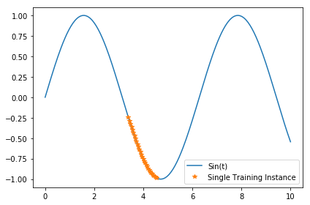
Deep Learning
We’ll first create a simple class to generate sin(x) and also grab random batches of sin(x)

Slide 65
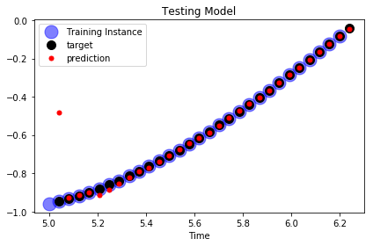
Deep Learning
Then the trained model will be given a time series and attempt to predict a time series shifted one time step ahead

Slide 66
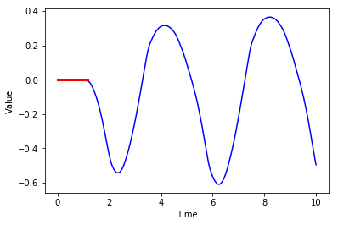
Deep Learning
Afterwards we’ll use the same model to generate much longer time series given a seed series.

Slide 67
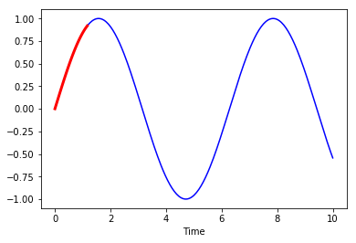
Deep Learning
Afterwards we’ll use the same model to generate much longer time series given a seed series.

Slide 68
Time Series Exercise

Slide 69
Time Series Exercise
Solutions

Slide 70
Quick Note on Word2Vec

Slide 71
Deep Learning
Optional series of lectures describing Word2Vec with TensorFlow.
Recommend you check out gensim library if you are further interested in Word2Vec.

Slide 72
Word2Vec

Slide 73
Deep Learning
Now that we understand how to work with time series of data, let’s take a look at another common series data source, words.
For example a sentence can be:
[“Hi”,”how”,”are”,”you”]

Slide 74
Deep Learning
In “classic” NLP , words are typically replaced by numbers indicating some frequency relationship to their documents.
In doing this, we lose information about the relationship between the words themselves.

Slide 75
Deep Learning
Count-Based
Frequency of words in corpus
Predictive Based
Neighboring words are predicted based on a vector space

Slide 76
Deep Learning
Let’s explore one of Neural Network’s most famous use cases in natural language processing:
The Word2Vec model created by Mikolov et al.

Slide 77
Deep Learning
The goal of the Word2Vec model is to learn word embeddings by modeling each word as a vector in n-dimensional space.
But why use word-embeddings?

Slide 78
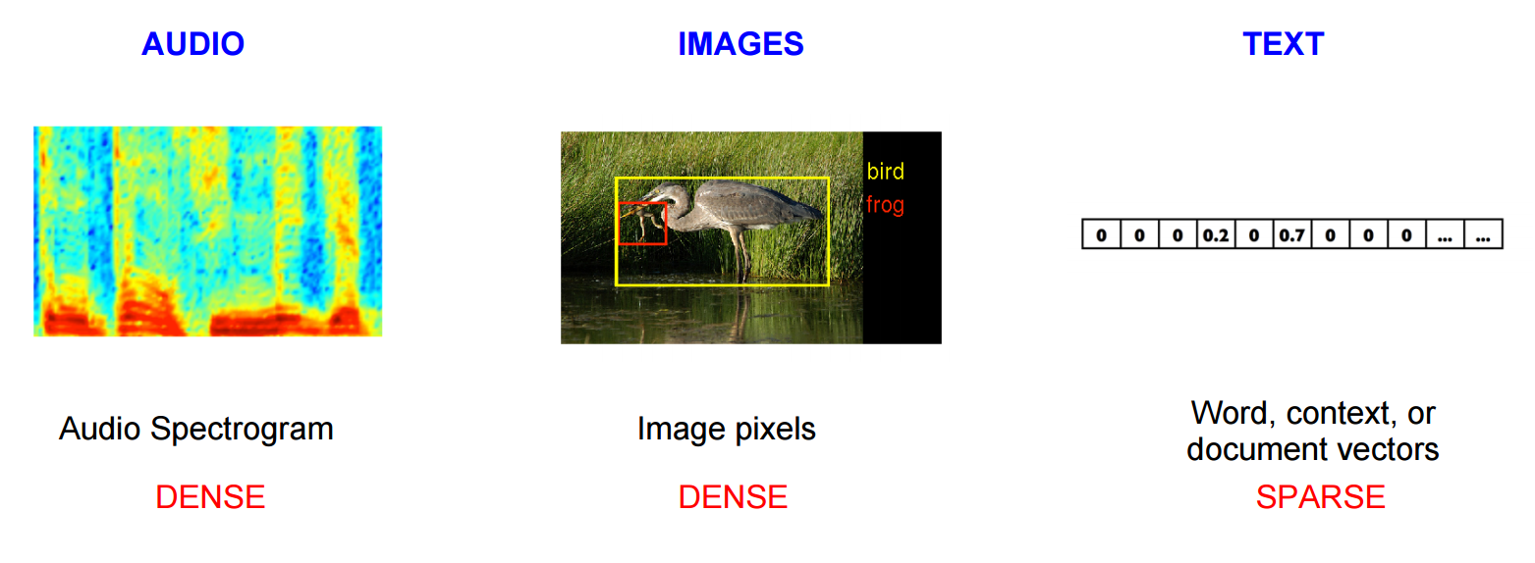
Deep Learning
Representation of Data

Slide 79
Deep Learning
Word2Vec creates vector spaced models that represent (embed) words in a continuous vector space.
With words represented as vectors we can perform vector mathematics on words (e.g. check similarity, add/subtract vectors)

Slide 80
Deep Learning
At the start of training each embedding is random, but through backpropagation the model will adjust the value of each word vector in the given number of dimensions.
More dimensions means more training time, but also more “information” per word

Slide 81
Deep Learning
Similar words will find their vectors closer together.
Even more impressive, the model may produce axes that represent concepts, such as gender, verbs, singular vs plural, etc...

Slide 82
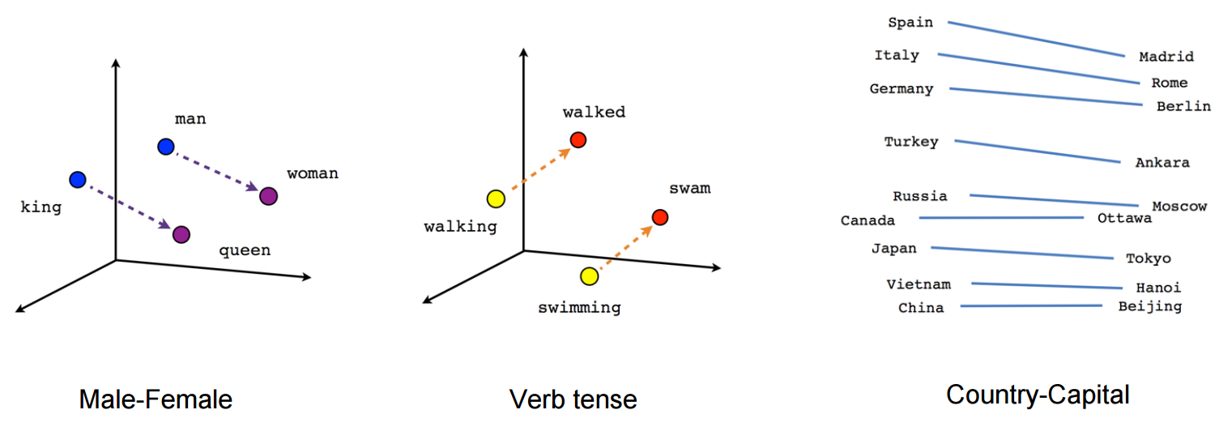
Deep Learning

Slide 83
Deep Learning
Similar words will find their vectors closer together.
Even more impressive, the model may produce axes that represent concepts, such as gender, verbs, singular vs plural, etc...

Slide 84
Deep Learning
Prediction Target
Skip-Gram Model
The dog chews the bone
Typically better for larger data sets
CBOW (Continuous Bag of Words)
The dog chews the bone
Typically better for smaller data sets

Slide 85
Deep Learning
The dog chews the w_{t}=?
bone vs
[book,car,house,sun,....guitar]
Target word
Noise words

Slide 86
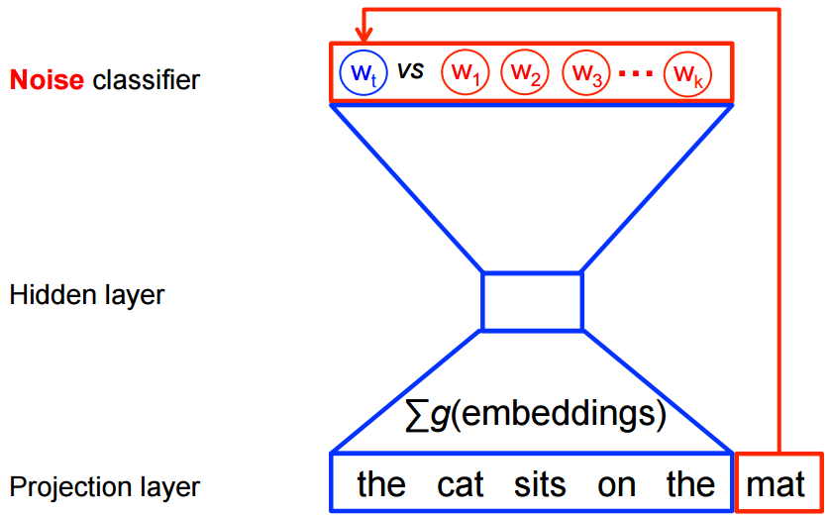
Deep Learning

Slide 87
Deep Learning
Noise-Contrastive Training
Target word is predicted by maximizing
J_{NEG} = log Q_{θ}(D=1|w_{t},h) + k_{n~Pnoise} Ε [log Q_{θ}(D=0|w_{n},h)]
Q_{θ}(D=1|w_{t},h) is binary logistic regression is the probability that the word w_{t} is in the context h in the dataset D parameterized by θ.

Slide 88
Deep Learning
Noise-Contrastive Training
Target word is predicted by maximizing
J_{NEG} = log Q_{θ}(D=1|w_{t},h) + k_{n~Pnoise} Ε [log Q_{θ}(D=0|w_{n},h)]
w_{n} are k words drawn from noise distribution

Slide 89
Deep Learning
Noise-Contrastive Training
Target word is predicted by maximizing
J_{NEG} = log Q_{θ}(D=1|w_{t},h) + k_{n~Pnoise} Ε [log Q_{θ}(D=0|w_{n},h)]
The goal is to assign high probability to correct words and low probability to noise words.

Slide 90
Deep Learning
Once we have vectors for each word we can visualize relationships by reducing the dimensions from 150 to 2 using t-Distributed Stochastic Neighbor Embedding .

Slide 91
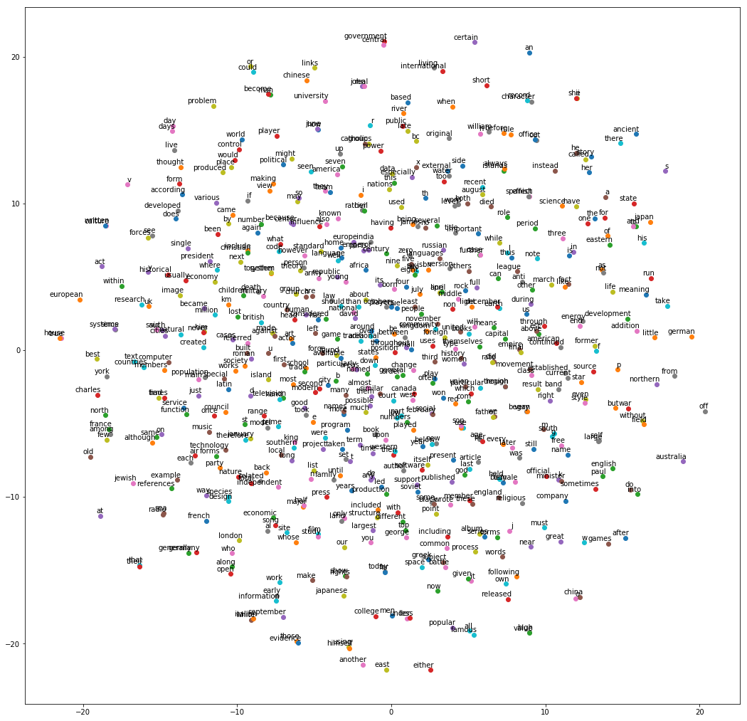
Deep Learning

Slide 92
Let’s get started!

Slide 93
Word2Vec Code Along

Slide 94
Deep Learning
We will be using the TensorFlow Documentation example implementation of Word2Vec.
We will be referring to the provided notebook for blocks of code often!

Slide 95
Deep Learning
If Word2Vec is something that interests you further, check out the gensim library for Python, it has a much simpler to use API for Word2Vec and additional functionality!

